Slide 1

COINX ANALYSIS
Deane Aulia Ahsanah

Slide 2
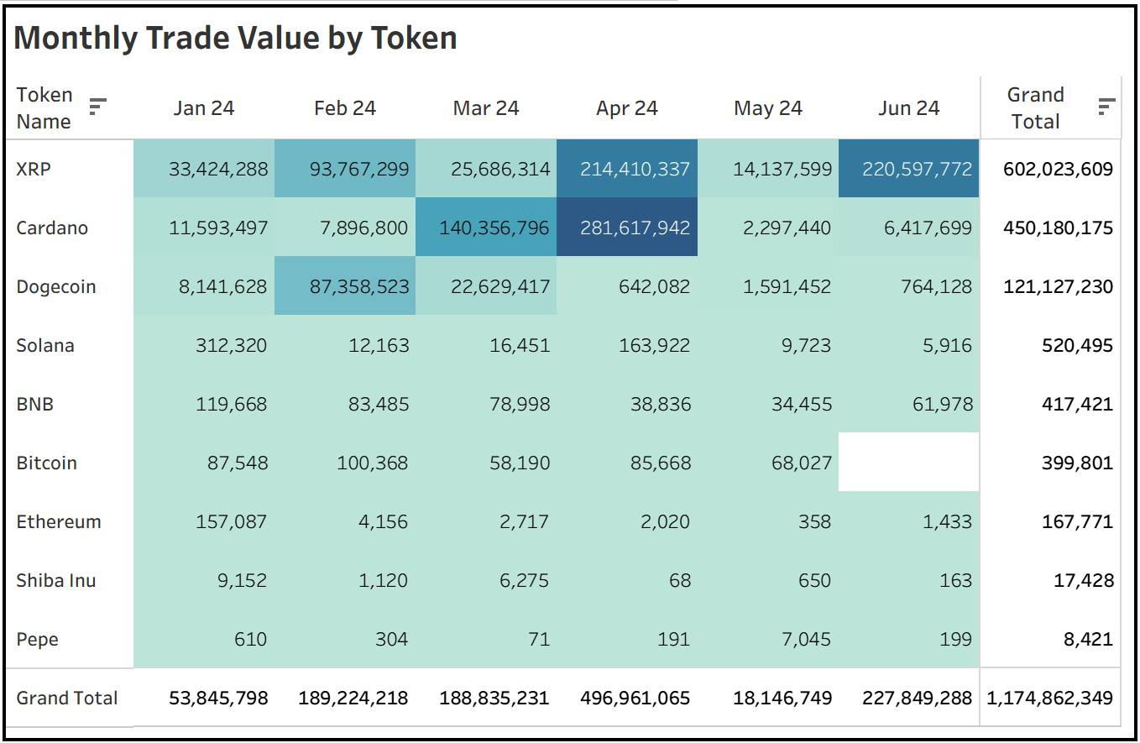
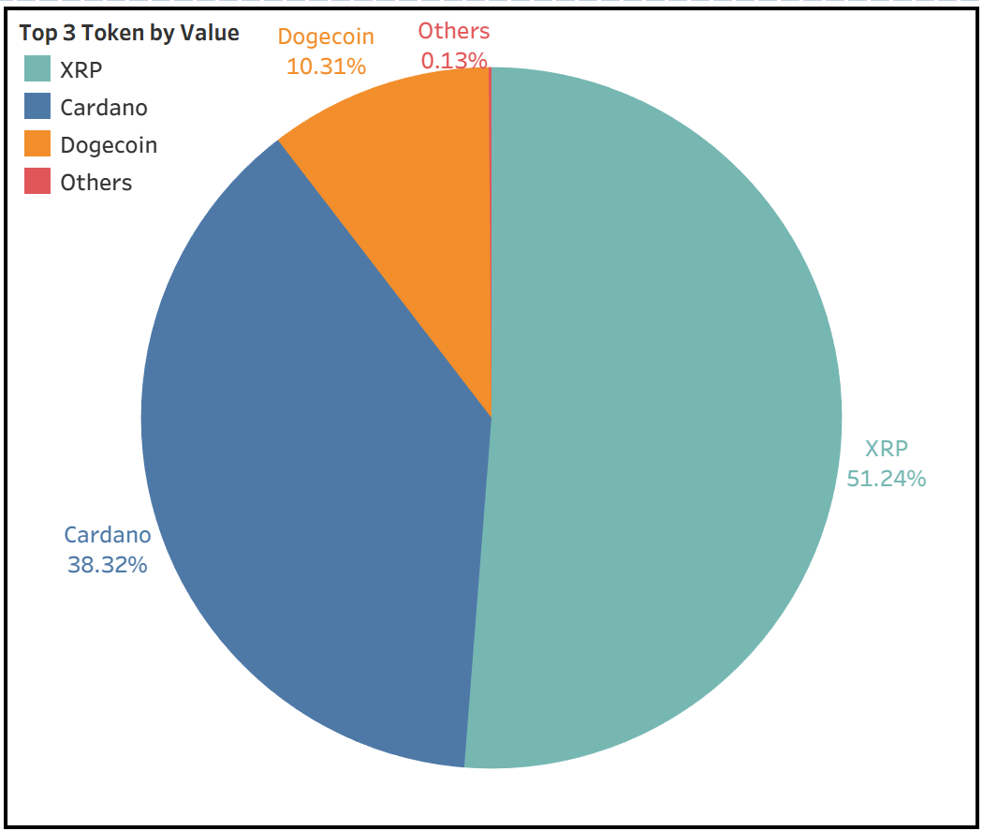
Trading Concentration
XRP, Cardano, and Dogecoin collectively account for 99.87% of total trading value, indicating that almost the entire trading activity is dominated by just three tokens.
XRP: 51.24% (≈ $602M)
Cardano: 38.32% (≈ $450M)
Dogecoin: 10.31% (≈ $121M)
All other 6 tokens combined: only 0.13% (≈ $1.1M)This distribution shows an extremely skewed market where the majority of activity is concentrated in a very small set of assets.

Slide 3
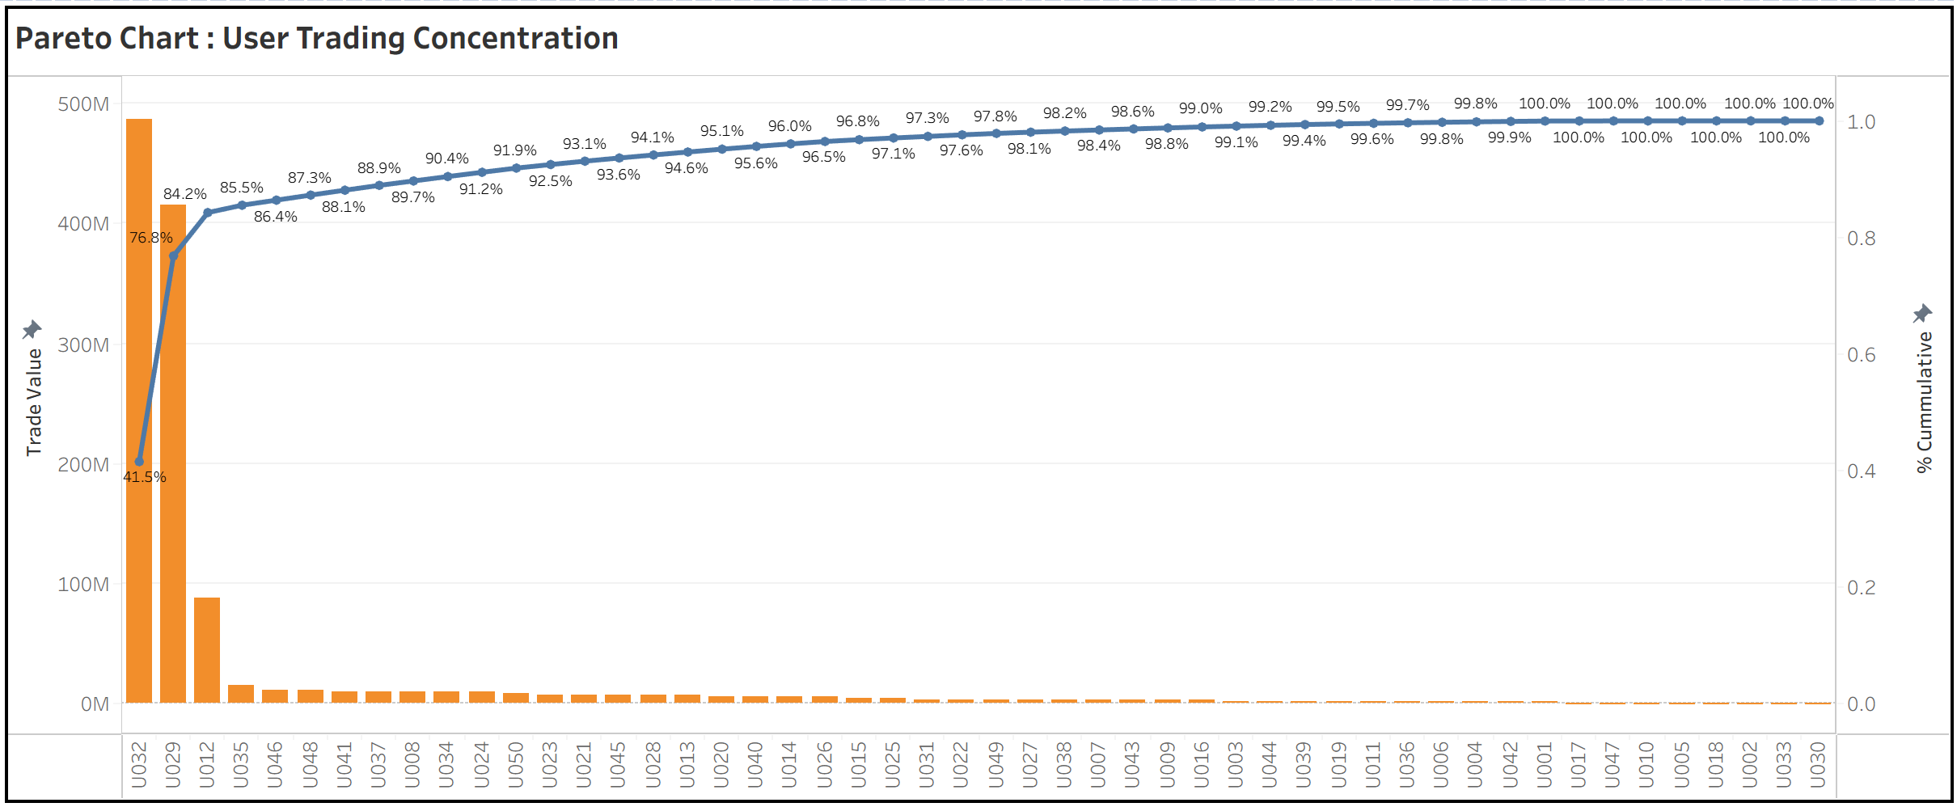
Trading Concentration
Platform trading volume is not broadly distributed. Instead, it is highly concentrated among a few top traders, indicating that total trading volume growth is likely inflated by a small set of users rather than broad organic growth.
Top 3 users contribute the majority of volume
The first user alone contributes ~41.5% of total trade value.
The second and third users push the cumulative share to ~84%.
This means 3 users = ~84% of all trading volume.

Slide 4
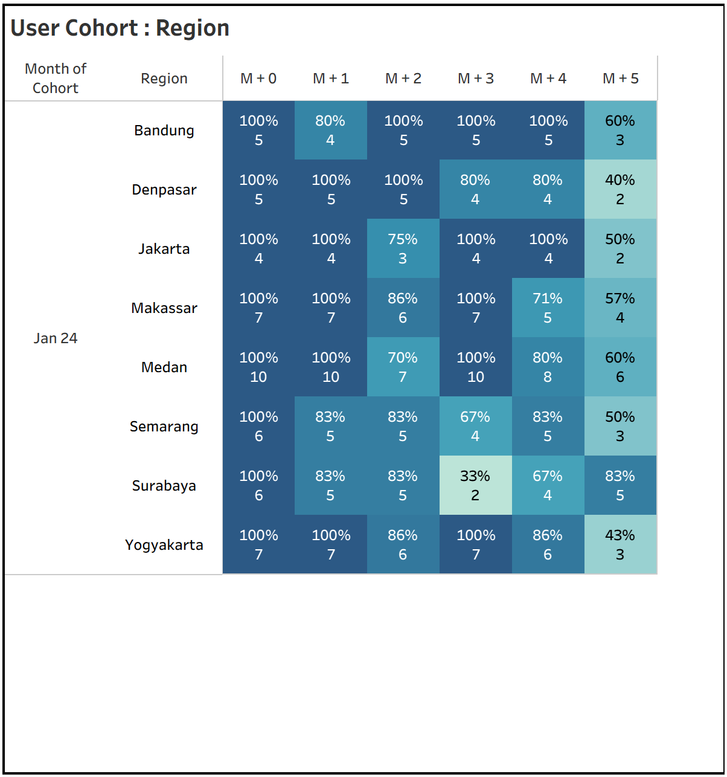
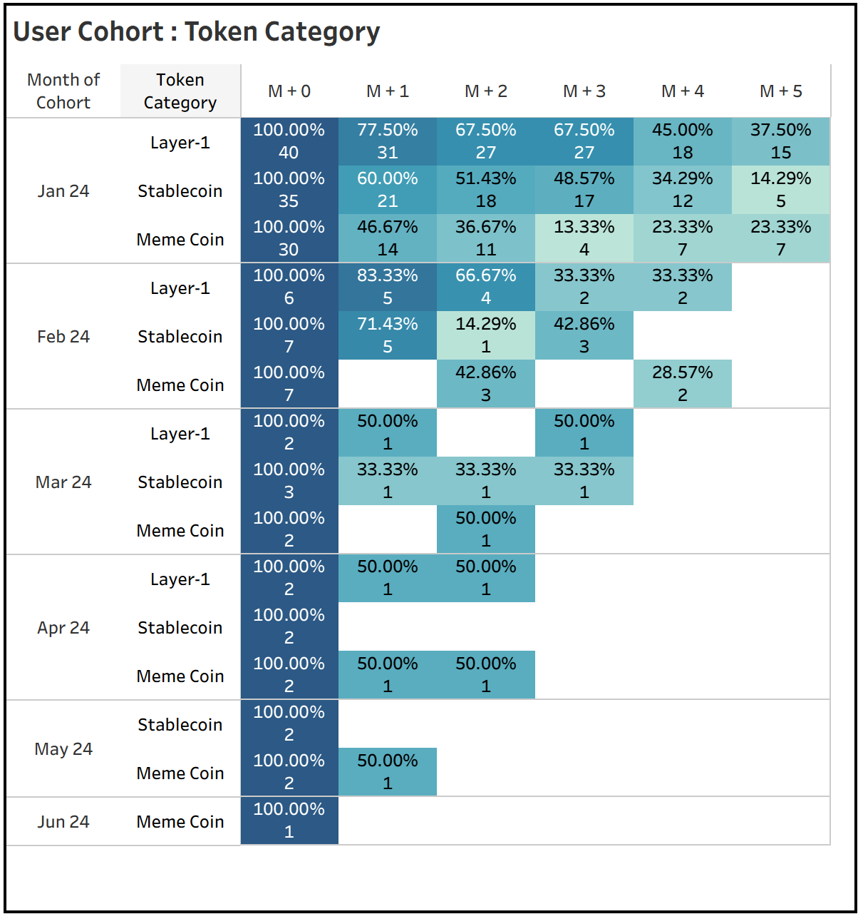
User Retention
Some regions show stable and consistently high retention up to M+5
Strong retention : Bandung, Medan, Makassar.
Moderate retention : Semarang, Yogyakarta.
Weak retention : Surabaya, Denpasar
Layer-1 tokens have the strongest and most stable retention.
Stablecoin users show mixed retention. Good early retention (60–100%), but decline faster by M+4/M+5
Meme coin users are the least sticky. Retention drops quickly.

